Slide 1
ME5402EE5106 Advanced Robotics EE5064: Dynamics and Control of Robotic Manipulators
Structures and Sense of Achievements
Shuzhi Sam Ge, FIEEE, PhD, DIC, BSc
Department of Electrical and Computer Engineering
National University of Singapore
Singapore 117576
E-mail: samge@nus.edu.sg / Tel: 6516 6821 / Office: E4-05-28
https://blog.nus.edu.sg/srlweb
Online/ Schedule: 6.00-9.00pm, Monday / Weeks 7- 12+

Slide 2
Table of Contents
1. Review of Kinematics: Sam
(a) General features of robots;(b) Formulation of Denavit – Hartenberg; (c) Direct kinematics and inverse kinematics;
2. Robot Dynamics: Sam
(a) Newton-Euler formulations; (b) Lagrangian Method;
(c) Properties of Dynamic Model; (d) Dynamic Tutorials and (e) Neural Network Modelling
3. Robot Position Control: Sam
(a) Fundamentals; (b) Single-joint position control; (c) Multi-joint position control and (d) Adaptive control
4. Robot Force Control: Sam
(a) Force control and hybrid position/force control; (b) Impedance control and intelligent control; (c) Control of constrained robots

Slide 3
Course assessment arrangement
The course assessment consists of three parts, and 100% CAs.
Continual Assessment (CA) 1: 35% from Prof. Chui Chee Kong.
CA 2: 35% of the total mark is from the Mini Project.
Open-book Exam: 30% of the total mark with the duration of 1 hour.

Slide 4
Description
The aim of the course is for students to develop an in-depth understanding of the fundamentals of robotics at an advanced level. It is targeted towards graduate students interested in robotics research and development. The focus is on in-depth treatments and wider coverage of advanced topics on
Kinematics and trajectory planning,
dynamics and control system design.
At the end of this module, the student should have a good understanding of all the related topics of advanced robotics, and be able to derive the kinematics and dynamics of a given robot, plan appropriate path, and design advanced control systems.
Notes:
What is the Turing Test?
The Turing Test is a method of inquiry in artificial intelligence (AI) for determining whether or not a computer (robot) is capable of thinking like a human being. The test is named after Alan Turing, the founder of the Turing Test and an English computer scientist, cryptanalyst, mathematician and theoretical biologist. Turing test is performed using natural language because language is the most natural way of human-human communication.

Slide 5
Pre-Requisite
You are highly suggested acquiring the following background/foundation before taking this module.
EE3331C/ME2142 Feedback Control Systems
Basic kinematics and dynamics of rigid body
Matlab/Python programming skills
Linear algebra
Notes:
What is the Turing Test?
The Turing Test is a method of inquiry in artificial intelligence (AI) for determining whether or not a computer (robot) is capable of thinking like a human being. The test is named after Alan Turing, the founder of the Turing Test and an English computer scientist, cryptanalyst, mathematician and theoretical biologist. Turing test is performed using natural language because language is the most natural way of human-human communication.

Slide 6

On Education
平庸的教师说教,
好的的教师讲解,
优秀的的教师示范,
伟大的的教师启发!
The mediocre teacher tells,
the good teacher explains,
the superior teacher demonstrates,
the great teachers inspires!
–––William Arthur Ward
Solid Feet
Strong Body
Roaring Soul

Slide 7
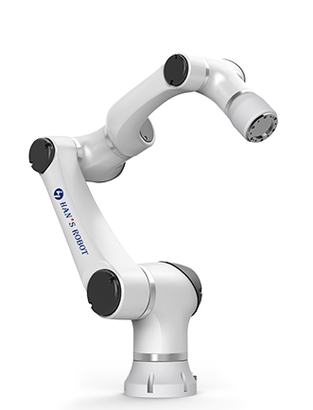
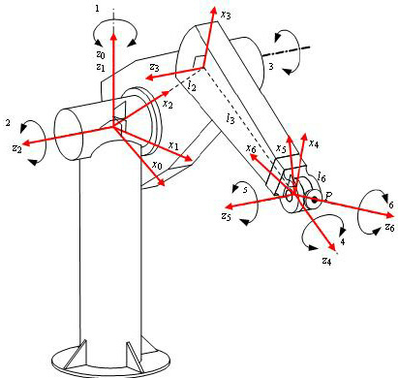
Chapter I Learning Outcomes:
Understand structure and general features of robots
Understand the formulation of Denavit – Hartenberg
Understand direct kinematics and inverse kinematics

Slide 8
Chapter II Learning Outcomes:
Can construct robot dynamics using Newton-Euler formulation
Be able to derive robot dynamics using Lagrangian
Understand properties of the robot dynamic models
Appreciate Neural Network (NN) approximations and NN Modelling of Robots

Slide 9
Chapter III Learning Outcomes:
Understand fundamentals of stability and control
Can design single joint control with good concepts of motor drive, effective inertia and resonant frequency
Understand three multi-joint control techniques: (i) computed torque method, (ii) Lyapunov’s method and (iii) adaptive method from simple to complex
Appreciate Adaptive NN Control

Slide 10
Chapter IV Learning Outcomes:
Understand Force control and hybrid position/force control
Understand Impedance control
Appreciate control of constrained robots

Slide 11
Chapter V - Group Projects:
Group projects with either 2 or 3 members of your own choices to sharpen your understanding, application and skills on
kinematics,
dynamics,
control and
simulation
based on a few typical robots to be released later with your own inspiration.

Slide 12

Educational Objectives
Fun and Interesting: kinematics, dynamic, control and relevance.
Sense of Achievements: Equipped with technical knowledge, you can achieve the sense of achievement and confidence through the group projects.
Practical and Useful: job perspectives are excellent for industry and further research!

